Slide 1



Good Morning!
October 12, 2023
Fall Institute
9 a.m. – 2 p.m.
Welcome to Carroll County Career and Technology Center
Did You Know?
ACTE-Maryland offers customized professional development opportunities for CTE teachers and some of it is free!
https://md.ctelearn.org/

Slide 2
Good Morning!
October 12, 2023
Check-in and Refreshments
Sharon Kramer, Executive Director, MCTA
Bill Eckles, Supervisor of Career and Technology Education, Carroll County
Did You Know?
ACTE-Maryland offers customized professional development opportunities for CTE teachers and some of it is free!
https://md.ctelearn.org/

Slide 3
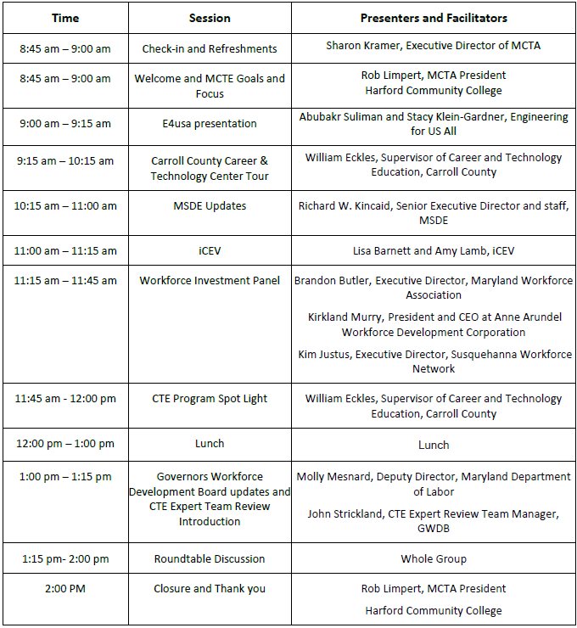
Agenda

Slide 4
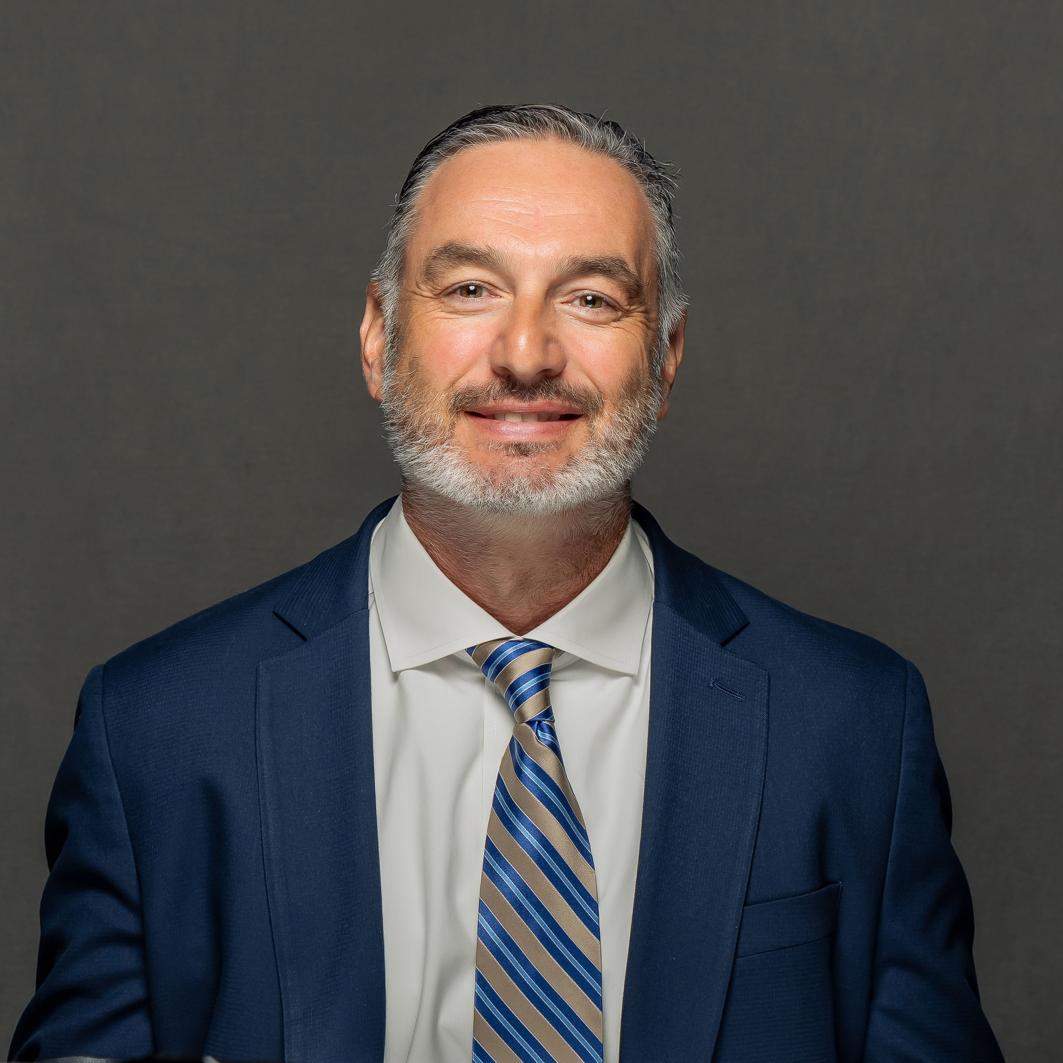
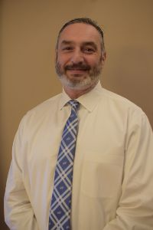
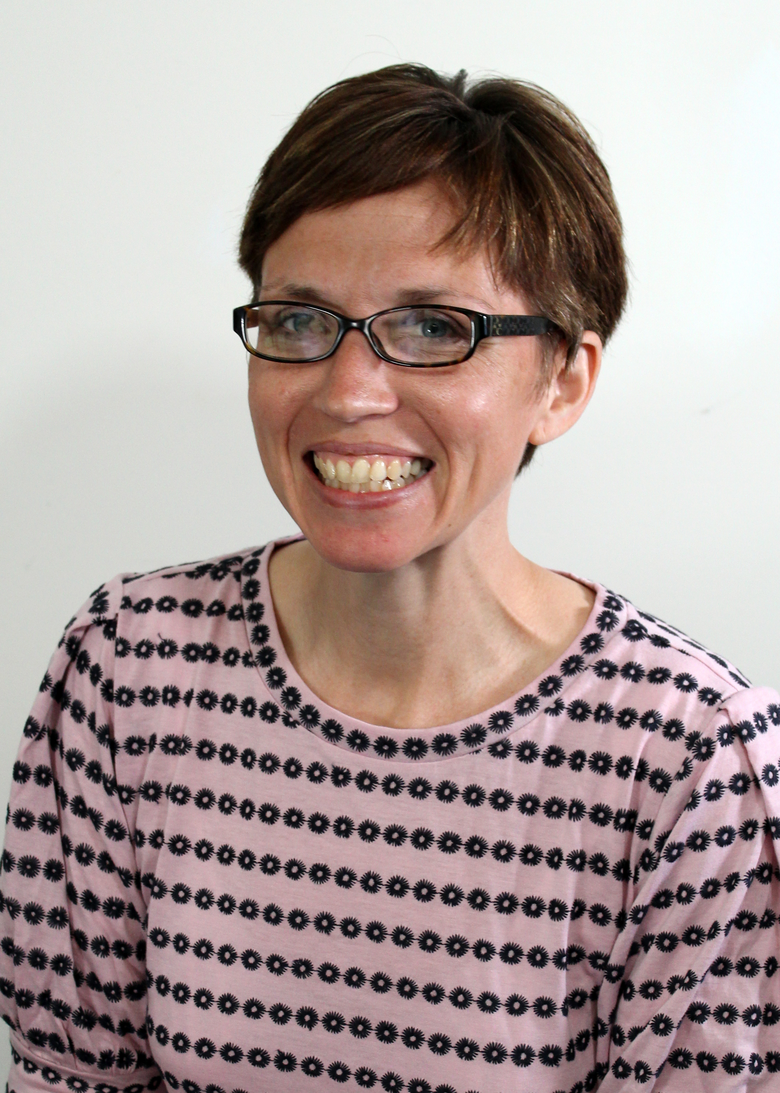
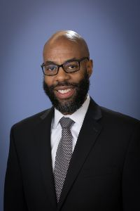
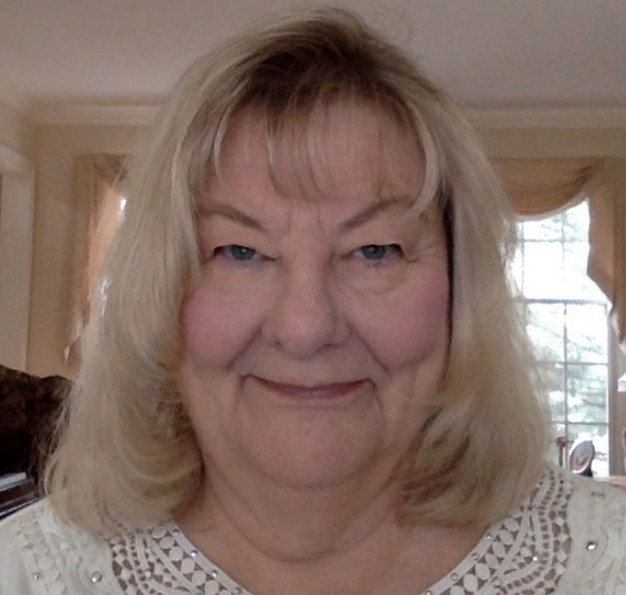
Executive Board
PRESIDENT
ROBERT M. LIMPERT
Harford Community College
PRESIDENT-ELECT
CarRie Akins
Calvert County Public Schools
PAST PRESIDENT
DOUGLAS HANDY
Baltimore County Public Schools
TREASURER/Executive Director
SHARON R. KRAMER
Howard County Public Schools (retired)

Slide 5
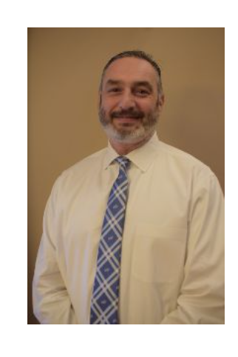
Welcome and MCTA Goals and Vision
8:45 a.m. – 9 a.m.
Mr. Robert Limpert
Director of Workforce Development
Harford Community College
MCTA President, 2022 - 2024

Slide 6

Vendor Presentation
Abubakr Suliman and Stacy Klein-Gardner
Engineering for US All

Slide 7

Tour
9:15-10:15
Tour of Carroll County Career and Technology Center
Bill Eckles, Supervisor of Career and Technology Education

Slide 8


MSDE Updates
Richard W. Kincaid
Senior Executive Director
MSDE

Slide 9

Vendor Presentation
Lisa Barnett and Amy Lamb
iCEV

Slide 10



Workforce Development Board Panel
Brandon Butler
Executive Director, Maryland Workforce Association
Kirkland Murry
President and CEO at Anne Arundel Workforce Development Corporation
Kim Justus
Executive Director, Susquehanna Workforce Network

Slide 11
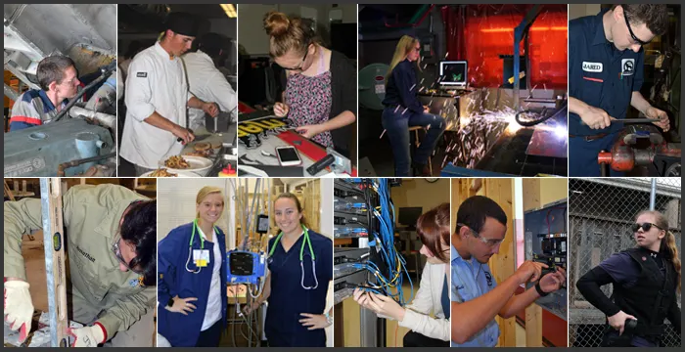
CTE Program Spotlight
William Eckles
Supervisor of Career and Technology Education

Slide 12

Region 1 Award Winners
ACTE VISION 2023 Conference

Slide 13
Lunch-
12:00-1:00 p.m.

Slide 14

Governors Workforce Development Board updates
Molly Mesnard, Deputy Director, Maryland Department of Labor

Slide 15
Roundtable Discussions
Whole
Group

Slide 16


Thank you!

Slide 17
Close and final word
President’s
Final words
Thank you for attending.
Please visit www.acte-maryland.org to take our conference survey.
Spring Conference – TBD

